Slide 1
Android Application Development (I)
Practice - Get started with Android

Slide 2
Agenda
Self Introduction
Intellectual Property Rights
Project Introduction
Android Introduction
Get Started with Android
Requirement
Object-Oriented Analysis and Design
Scrum
Project Breakdown
Acceptance Test Criteria
Publish Application
Notes:
Object-oriented analysis and design (OOAD) is a software engineering approach that models a system as a group of interacting objects. Each object represents some entity of interest in the system being modeled, and is characterised by its class, its state (data elements), and its behavior. Various models can be created to show the static structure, dynamic behavior, and run-time deployment of these collaborating objects. There are a number of different notations for representing these models, such as the Unified Modeling Language (UML).
Object-oriented analysis (OOA) applies object-modeling techniques to analyze the functional requirements for a system. Object-oriented design (OOD) elaborates the analysis models to produce implementation specifications. OOA focuses on what the system does, OOD on how the system does it.
Ref: http://en.wikipedia.org/wiki/Object-oriented_analysis_and_design
IFRS - International Financial Reporting Standards
GAAP - Generally Accepted Accounting Principles

Slide 3
Outline
Development Environment
Getting Start with Android

Slide 4
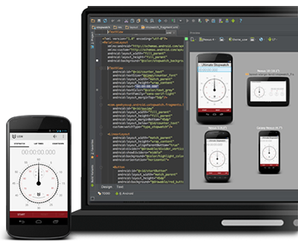
IDE Options
Get the ADT Bundle
Based on Eclipse (ADT Bundle)
SDK Manager
Get from here
Upgrade an Existing IDE
Eclipse Plugin - Android Development Tools (ADT)
SDK Manager
Get the Android Studio
Based on IntelliJ IDEA
SDK Manager
Get from here

Slide 5
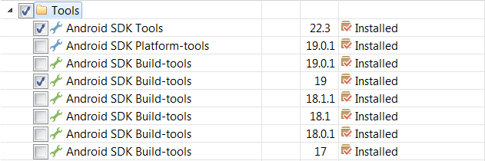
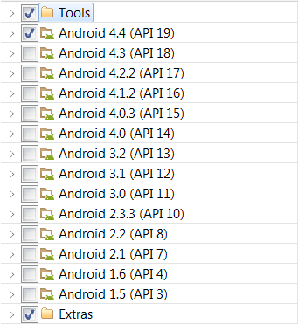
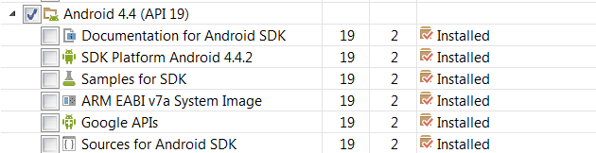
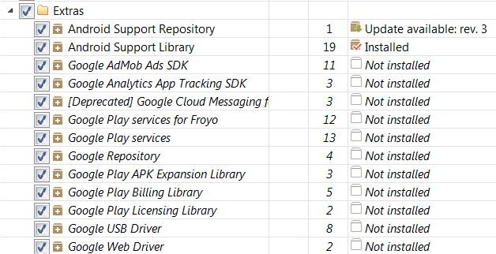
SDK Manager

Slide 6
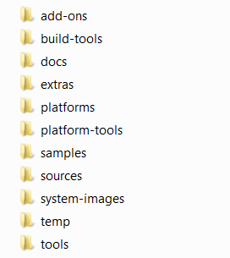
SDK Composition
SDK add-on for special Google APIs, such as map
Tools for app compile
Offline documentation for the Android platform APIs
Static library to use powerful APIs, such as GCM
Android.jar file with a fully compliant Android library
Platform-dependent tools for developing and debugging, such as ADB
A collection of sample apps
Source for Android.jar
System images (ARM and x86)
Temporary files
Tools for debugging and testing, plus other utilities

Slide 7
Outline
Development Environment
Getting Start with Android

Slide 8
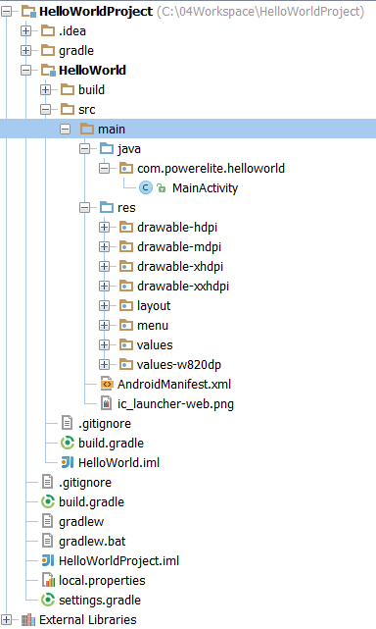
Build the App
Source for Java class files
Resources, such as images, layouts, menus, values, etc
00
To describe the fundamental characteristics of the app and defines each of its components

Slide 9
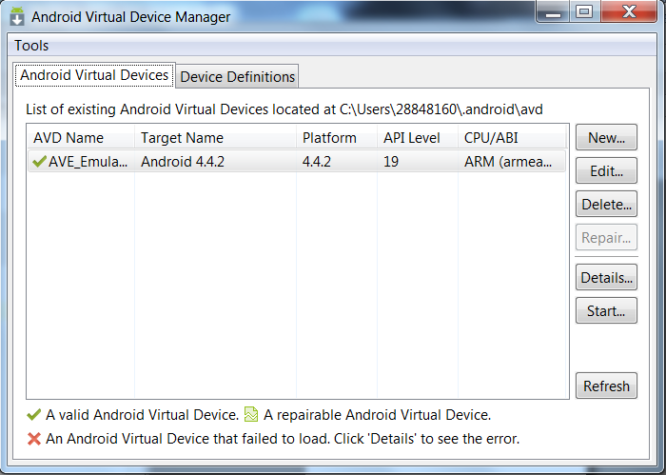
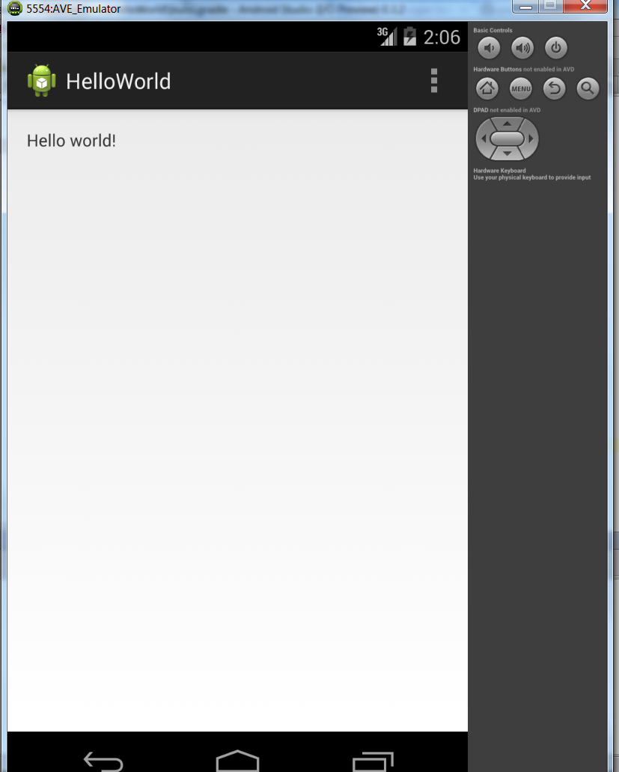
Run the App
\app directory>ant debug
\app directory>adb install bin/MyFirstApp-debug.apk

Slide 10
Logs of App Launch
Waiting for device.
Target device: AVE_Emulator [emulator-5554]
Uploading file
local path: C:\04Workspace\HelloWorldProject\HelloWorld\build\apk\HelloWorld-debug-unaligned.apk
remote path: /data/local/tmp/com.powerelite.helloworld
Installing com.powerelite.helloworld
DEVICE SHELL COMMAND: pm install -r "/data/local/tmp/com.powerelite.helloworld"
pkg: /data/local/tmp/com.powerelite.helloworld
Success
Launching application: com.powerelite.helloworld/com.powerelite.helloworld.MainActivity.
DEVICE SHELL COMMAND: am start -n "com.powerelite.helloworld/com.powerelite.helloworld.MainActivity" -a android.intent.action.MAIN -c android.intent.category.LAUNCHER
Starting: Intent { act=android.intent.action.MAIN cat=[android.intent.category.LAUNCHER] cmp=com.powerelite.helloworld/.MainActivity }

Slide 11
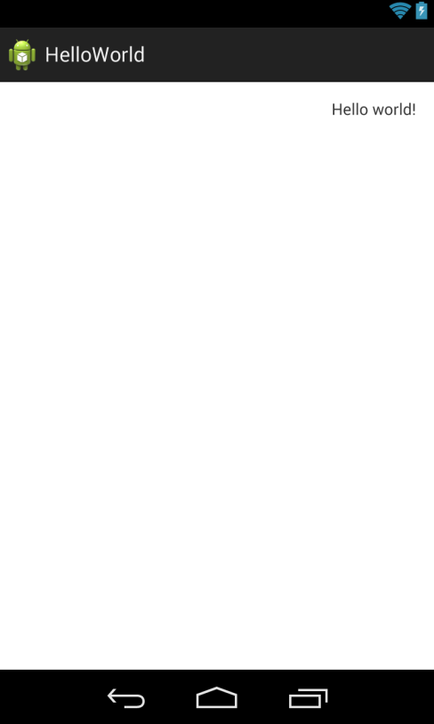
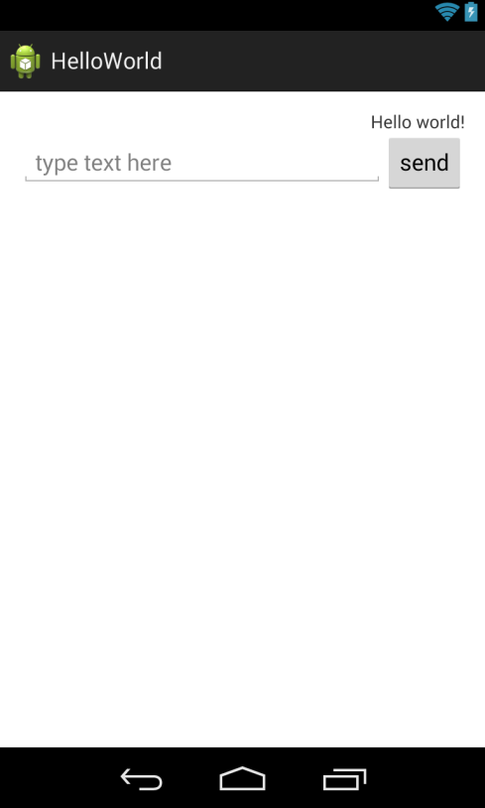
Add more UIs
<RelativeLayout xmlns:android="http://schemas.android.com/apk/res/android"
xmlns:tools="http://schemas.android.com/tools"
android:layout_width="match_parent"
android:layout_height="match_parent"
android:paddingLeft="@dimen/activity_horizontal_margin"
android:paddingRight="@dimen/activity_horizontal_margin"
android:paddingTop="@dimen/activity_vertical_margin"
android:paddingBottom="@dimen/activity_vertical_margin"
android:orientation="vertical"
tools:context=".MainActivity$PlaceholderFragment">
<TextView android:id="@+id/text_message"
android:text="@string/hello_world"
android:layout_width="wrap_content"
android:layout_height="wrap_content"
android:layout_alignParentRight="true"/>
<!-- add linear layout -->
<LinearLayout
android:layout_width="match_parent"
android:layout_height="match_parent"
android:layout_below="@id/text_message"
android:orientation="horizontal">
<EditText android:id="@+id/edit_message"
android:layout_weight="1"
android:layout_width="0dp"
android:layout_height="wrap_content"
android:hint="type text here" />
<Button
android:layout_width="wrap_content"
android:layout_height="wrap_content"
android:text="send" />
</LinearLayout>
</RelativeLayout>

Slide 12
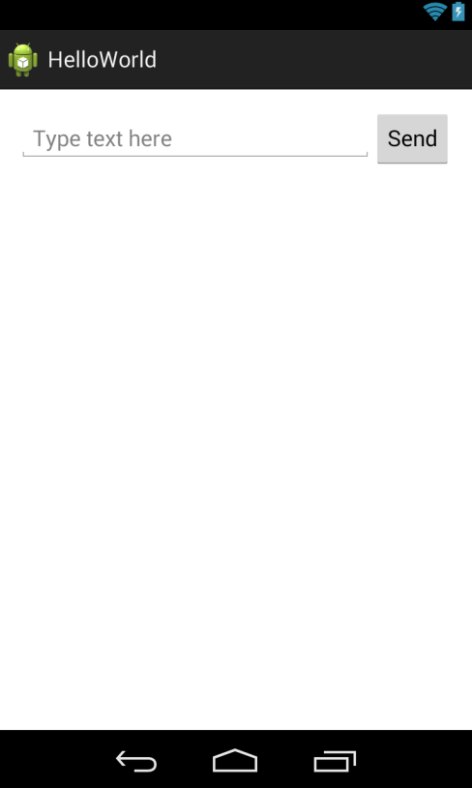

Another Activity
res/layout/fragment_main.xml
<LinearLayout xmlns:android="http://schemas.android.com/apk/res/android"
xmlns:tools="http://schemas.android.com/tools"
…
tools:context=".MainActivity$MainFragment">
<EditText android:id="@+id/edit_message"
android:layout_weight="1"
android:layout_width="0dp"
android:layout_height="wrap_content"
android:hint="Type text here"/>
<Button android:id="@+id/send_button"
android:layout_width="wrap_content"
android:layout_height="wrap_content"
android:text="@string/button_send" />
</LinearLayout>
res/layout/fragment_text.xml
<RelativeLayout xmlns:android="http://schemas.android.com/apk/res/android"
xmlns:tools="http://schemas.android.com/tools"
…
android:orientation="vertical"
tools:context=".TextActivity$TextFragment">
<TextView android:id="@+id/text_message"
android:layout_width="wrap_content"
android:layout_height="wrap_content"
android:text="@string/hello_world"
android:layout_alignParentRight="true"/>
</RelativeLayout>

Slide 13
Another Activity Cont.
MainActivity.java
public View onCreateView(LayoutInflater inflater, ViewGroup container,
Bundle savedInstanceState) {
final LinearLayout mLinearLayout = (LinearLayout) inflater.inflate(R.layout.fragment_main, container, false);
Button mButton = (Button) mLinearLayout.findViewById(R.id.send_button);
mButton.setOnClickListener(new OnClickListener() {
public void onClick(View v) {
// Perform action on click
Intent intent = new Intent();
intent.setClass(getActivity(), TextActivity.class);
EditText editText = (EditText) mLinearLayout.findViewById(R.id.edit_message);
String message = editText.getText().toString();
intent.putExtra(EXTRA_MESSAGE, message);
startActivity(intent);
}
});
return mLinearLayout;
}
TextActivity.java
public View onCreateView(LayoutInflater inflater, ViewGroup container,
Bundle savedInstanceState) {
final RelativeLayout mRelativeLayout = (RelativeLayout) inflater.inflate(R.layout.fragment_text, container, false);
TextView mText = (TextView) mRelativeLayout.findViewById(R.id.text_message);
String mEditText = getActivity().getIntent().getStringExtra(EXTRA_MESSAGE);
mText.setText(mEditText);
return mRelativeLayout;
}

Slide 14
ADB – Android Debug Bridge
A command line tool (C/S) that lets you communicate with an emulator instance or connected Android-powered device.
Syntax: adb [-d|-e|-s <serialNumber>] <command>
Direct an adb command to the only attached USB device.
Direct an adb command to the only running emulator instance.
Direct an adb command a specific emulator/device instance
Get more about ADB from here

Slide 15
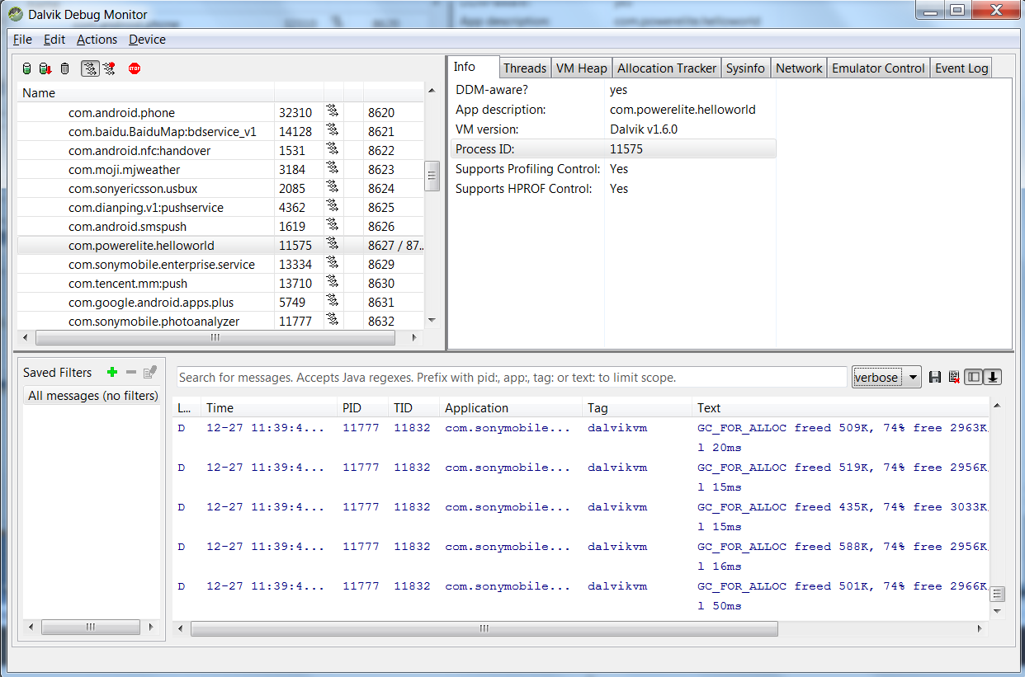
DDMS – Dalvik Debug Monitor Server
Get more about DDMS from here

Slide 16
Logs
The Log Class
Log.v(String, String) (verbose)
Log.d(String, String) (debug)
Log.i(String, String) (information)
Log.w(String, String) (warning)
Log.e(String, String) (error)
logcat
[adb] logcat [<option>] ... [<filter-spec>] ...
Example:
adb logcat ActivityManager:I MyApp:D *:S >c:\logcat.txt
Tag
Priority
Get more about Hierarchy Viewer from here

Slide 17
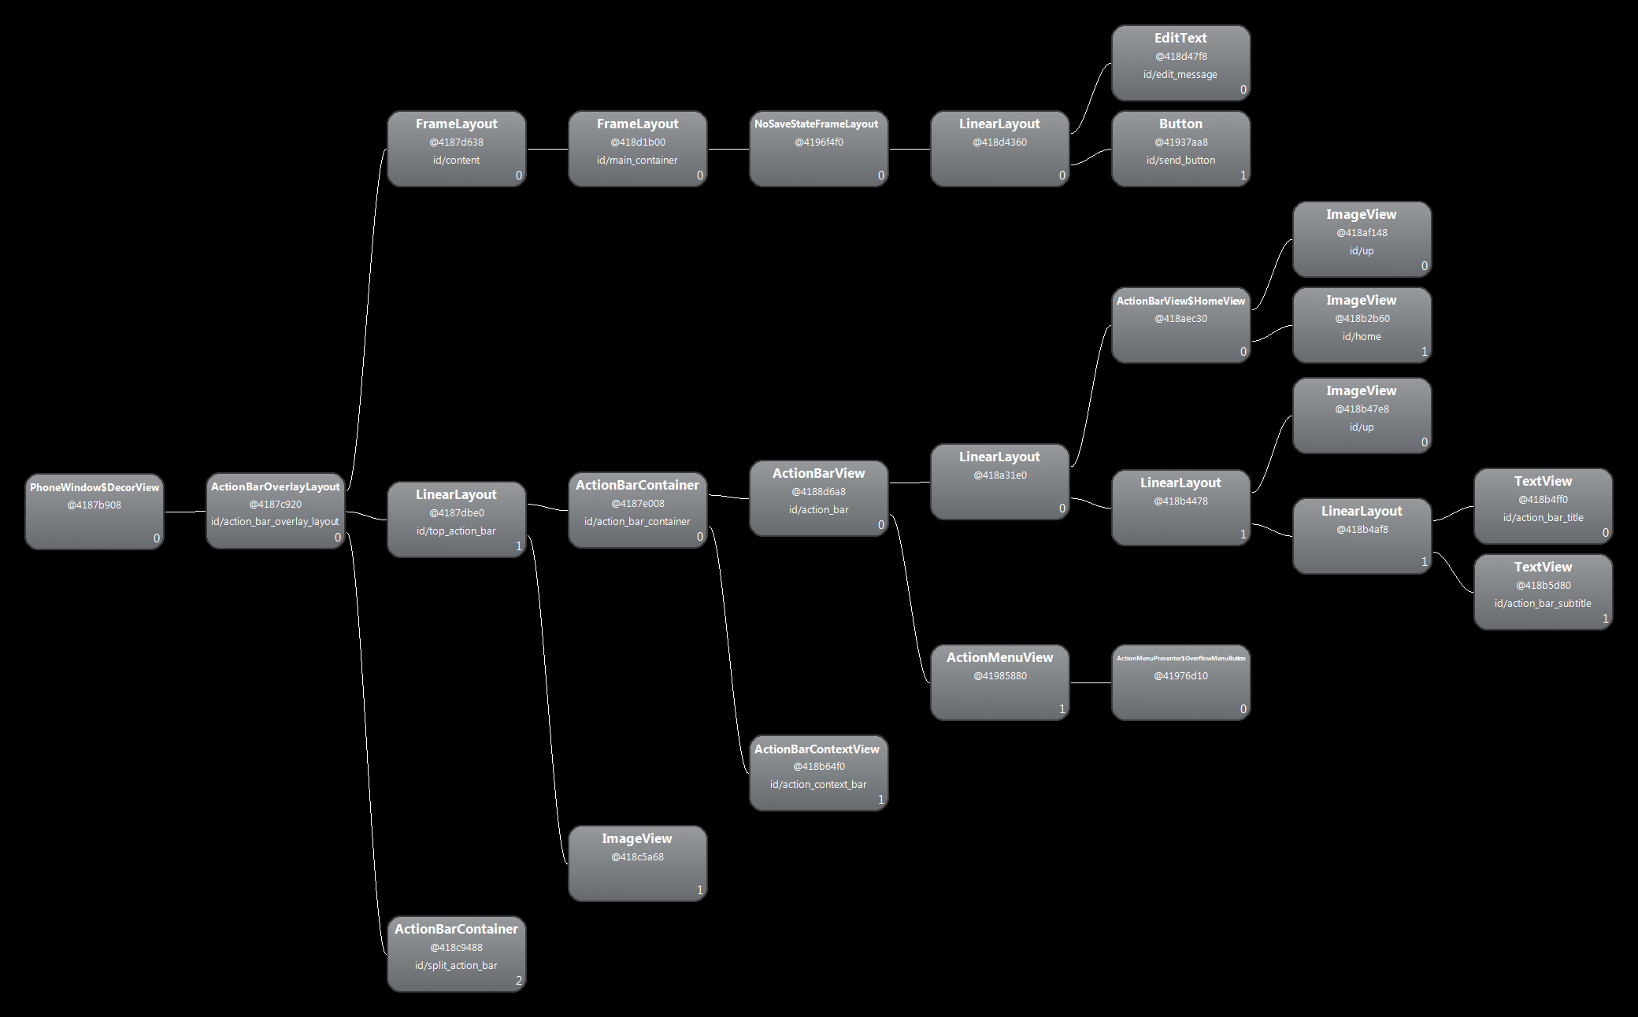
Hierarchy Viewer
Get more about Hierarchy Viewer from here

